Slide 1
CS 2600 Computer Networks I Dr. Sayeed Sajal Lecture 13 Test 1 Post Mortem

Slide 2
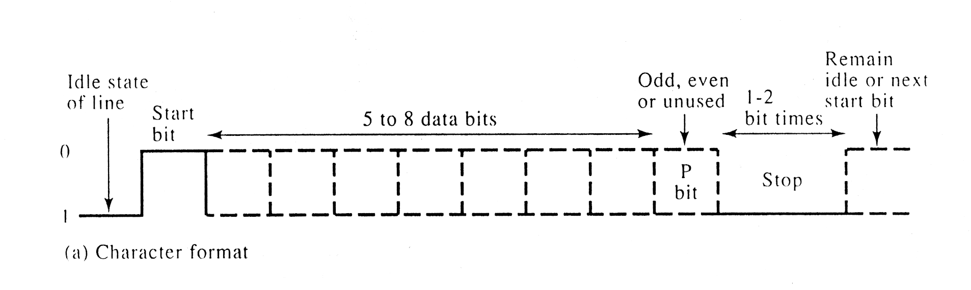
An Asynchronous Transmission (“Async”) Frame
(NRZ signal)
7 data bits (text character)
1
Stop
0
From Data and Computer Communications, 4th Ed. by W. Stallings (Prentice Hall)

Slide 3
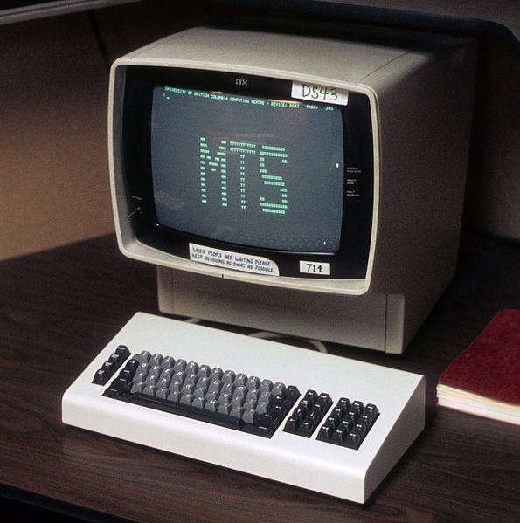
IBM 3270 Series Terminal
Typical computer terminal containing a simple processor and a few KB of onboard memory (circa 1970). These used a byte-oriented synchronous frame at the Data-link layer.
http://en.wikipedia.org/wiki/IBM_3270

Slide 4
Quiz Next Time
Covers Lectures 10 - 13, which includes pages 74 – 75 and 78 – 81 (Encoding, Modulation/Shift Keying, last mile solutions including DSL and cable modems, noise, and the Shannon-Hartley Theorem). Note that much of this is not covered in detail in the text.

